Slide 1
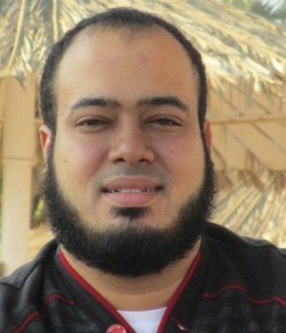
Competitive Programming From Problem 2 Solution in O(1)
P
T
H
I
N
K
F
A
S
T
S
Educational Management System - 3
Mostafa Saad Ibrahim
PhD Student @ Simon Fraser University

Slide 2
Identifying the Objects
Read project description...identify all nouns...see if any of these nouns is composed of attributes….and need operations
Student, Doctor, Teaching Assistant, Assignment, Course => Seems promising objects

Slide 3
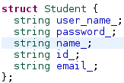




Identifying the Attributes

Slide 4
Identifying the relationships
Doctor
Can teach many courses
Student
Can register in many courses
Can submit many solutions (1 per assignment)
Course
Can be registered by many students
Can be taught by 1 course
Assignment
Belong to 1 course
Can have many submitted solutions (1 per student)

Slide 5
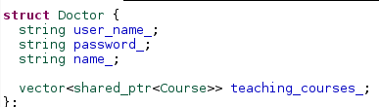
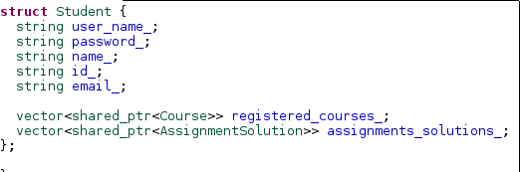
Code the relationships

Slide 6
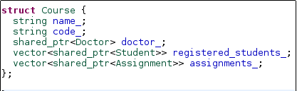
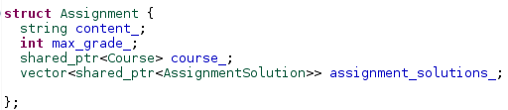

Code the relationships

Slide 7
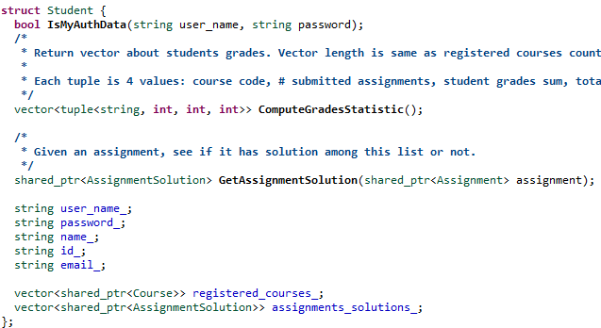
Identify Objects methods
What can we do over a student object?

Slide 8
Managing sets of objects
The system has more than 1 instance of objects
We have many courses
We have many doctors
We have many students
…
Let’s have a manager class for each type
Responsibility: Do operations over set of items

Slide 9
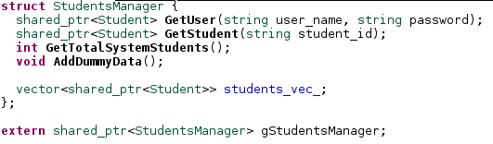
Students Manager

Slide 10
Controlling the flow
A real application interact with user
It allows signin - signup
Once logged in, it display customized menu for him
E.g. in doctor menu: Create Assignment
E.g. in student menu: Show my grades stat
It will also be responsible on printing data
Let’s have some flow classes…
General one for sign in
Specific one for each user (doctor, student…)

Slide 11
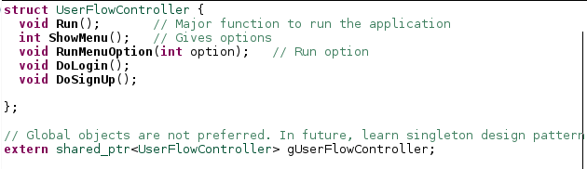
User flow controller

Slide 12
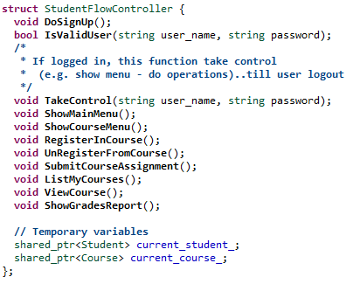
Student flow controller

Slide 13
The Responsibility Principle
Develop your code such that it minimizes its responsibilities..do minimum things
This way, function has less lines….class has only related methods
Whenever you feel some lines of code can be moved to a new function..move them...this makes code cleaner - maintainable
Can separate 1 class staff to many classes, each has different responsibilities? => do it

Slide 14
Responsibilities around Student
We can have 1 student struct...put all methods in it….this makes it big..hard to maintain
We broke that to 3 responsibilities
student
attributes, methods on attributes (except show methods)
students-manager
collection of students, any operation on all of them
student-flow-controller
menu, login, logout, signup, show student data (course, grades)

Slide 15
Dummy Data Generation
Each struct has its own data...and pointers to others..so we have circular data!
An approach to fill data..fill basic data of each struct manager…
Then back again fill relationships...e.g. get some students add them to course...and link each student to this course...etc

Slide 16
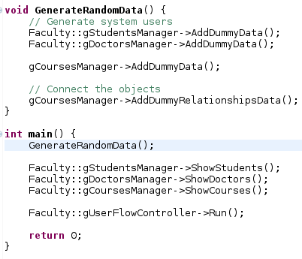
Application Driver

Slide 17
Let’s jump in the code

Slide 18
Homework
Attached eclipse project
It compiles and run
It implements most of basic level, but not all (e.g. no teaching assistant struct)
Your turn...understand the code
Finalize the basic level
Do the advanced level
Add more features from acadox
Do other projects (e.g. facebook)

Slide 19
تم بحمد الله
علمكم الله ما ينفعكم
ونفعكم بما تعلمتم
وزادكم علماً

